Slide 1






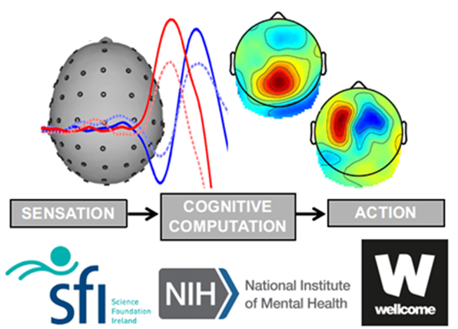




Brain mechanisms for keeping track of volatile environmental states
12/05/2021
Bachelor's thesis - May 2022
School of Electrical and Electronic Engineering
University College Dublin,
Biomedical Engineering, Dublin, Ireland,
liang.tong@ucdconnect.ie
Liang Tong
17208987
Supervisors :
Prof. Simon Kelly
Dr. Elisabet Parés-Pujolràs
Examiners :
Prof. Simon Kelly
Prof. Emer Doheny
Notes:
Good morning, welcome to my thesis presentation. My name is Liang Tong. The title of my project is Brain mechanisms for keeping track of volatile environmental states.

Slide 2
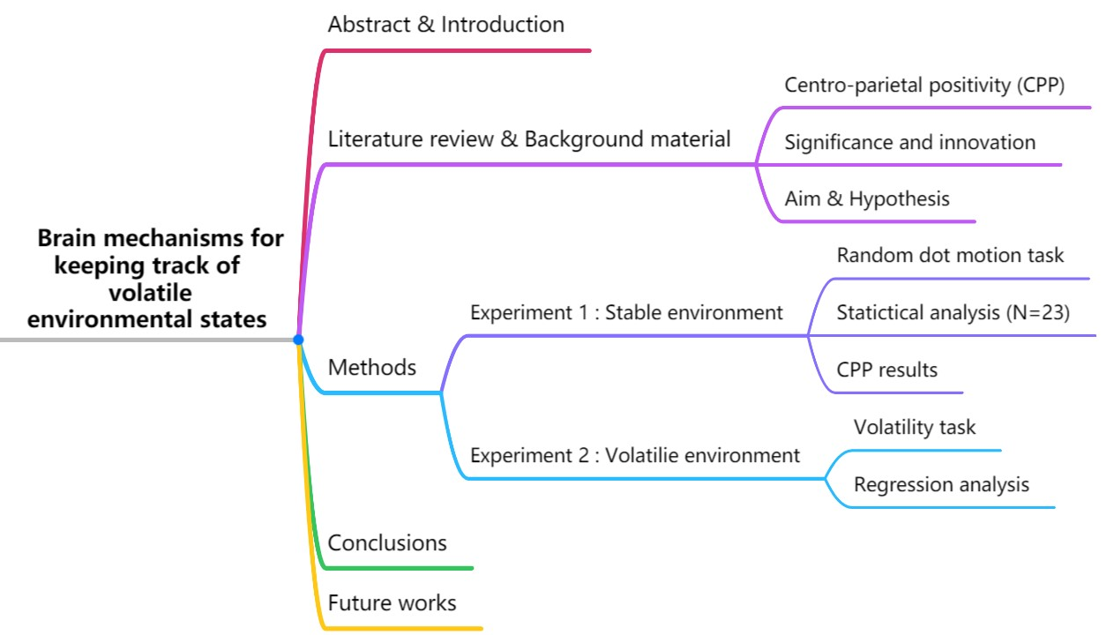
Notes:
the Mind Map briefly shows the structure of my presentation.

Slide 3
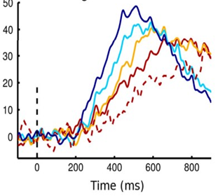
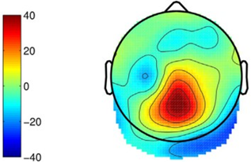
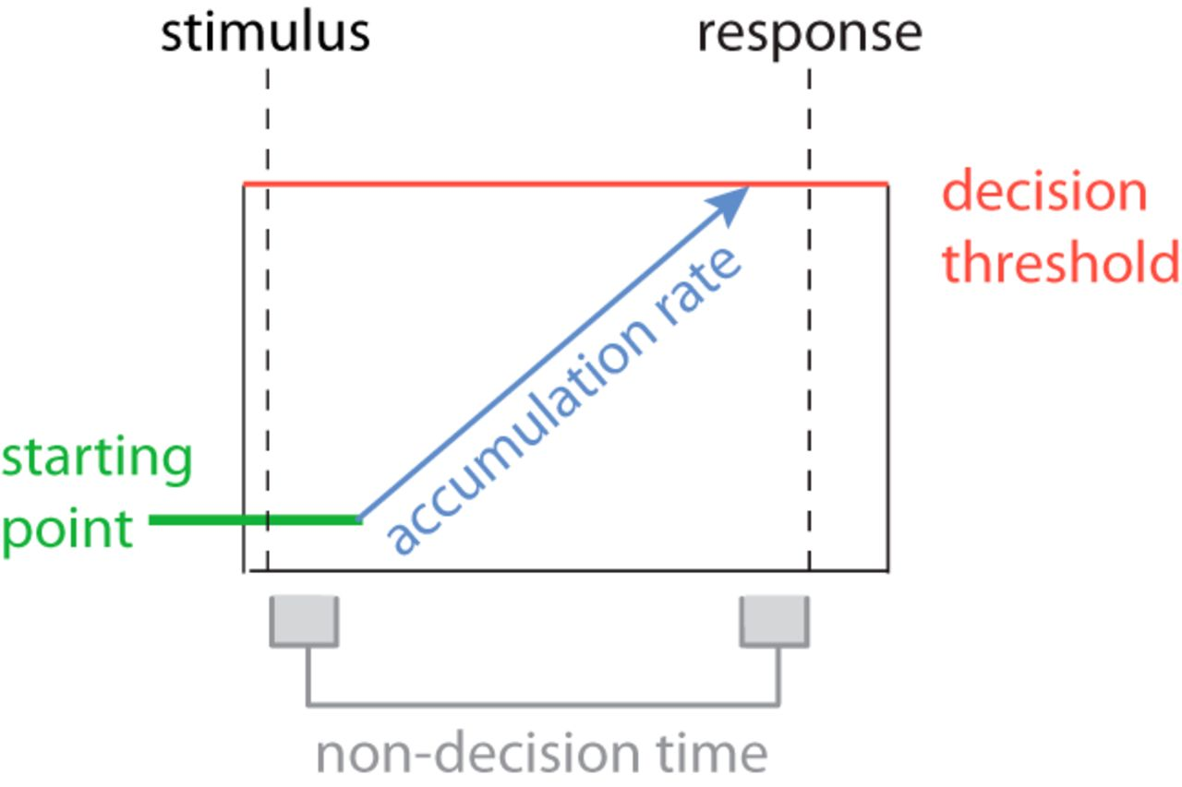
Centro-parietal positivity (CPP)
A newly discovered signal (CPP) extracted from EEG recordings by O’Connell et al [2] can track the decision-making process dynamically.
CPP has the characteristics of gradual accumulation until the threshold value.
Very similar to the P300
Peaks at the time of decision or at the time of the action.
Fig.1 CPP signals (left); Scalp topography (middle); Accumulation model (right)
Notes:
As a newly discovered signal related to decision making. CPP is very similar to the P300 signal, which has been known for many years but its precise functional meaning remains unknown. CPP has been defined as a signal that has been found in the parietal area of the brain, and can be used to track evidence accumulation during decision-making process. One of the most important features of CPP is it peaks at the time of decision or at the time of the action. Although they are simiar, CPP can better separate and observe the process in the brain when the time participants received different sensory evidence as well as show the changes in the decision variables. Moreover, there may exist internal relations between CPP and motor preparation

Slide 4
Introduction & Background
Most previous studies have used continuous stimuli to identify cumulative evidence from human brain signals.
But in real life, information always comes in separate bits.
No study has yet examined how the CPP behaves:
(a) when integrating discrete, sequential pieces of information
(b) in volatile environments
Significance of this study
The dynamics of how the human brain processes sensory information in different environment state would be revealed for the first time.
Notes:
Previous studies have proven that sensory information can accumulate overtime during a decision-making process. But what happened during the gap of these discrete sensory information is still unknown. Moreover, how the brain integrate these pieces of information seems different in stable or volatile environment.
In this project, the dynamics of how the human brain processes sensory information in an unstable environment would be revealed for the first time, and is of great significance not only for the diagnosis of clinical neurological disorders but also for the study of cognitive neuroscience

Slide 5
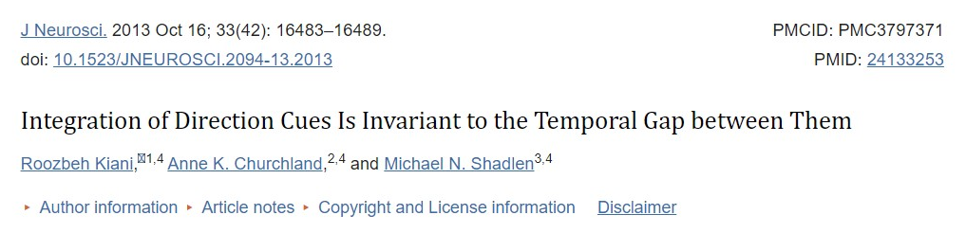
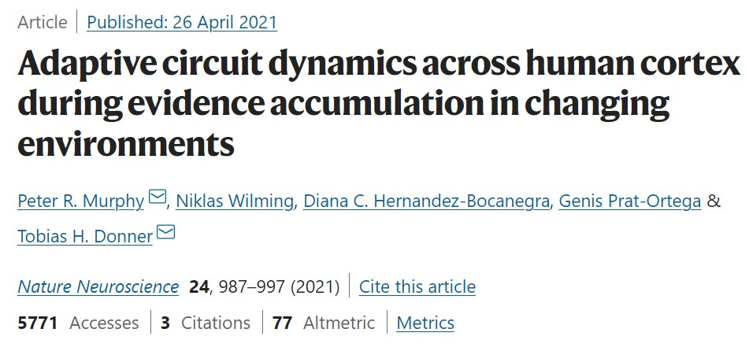
Notes:
Two experiments are selected and designed to suit both decisions scenarios
Kiani’s task and Murphy’s perceptual choice task were chosen in this study not only because they are both well characterized and been analysed in the literature
before, but also the behaviour analysis is understood quite well from previous research.
So that based on previous studies’ results on the mechanisms for doing those tasks and their clear behaviour analysis, new properties of the CPP are expected to be discovered in this
study

Slide 6
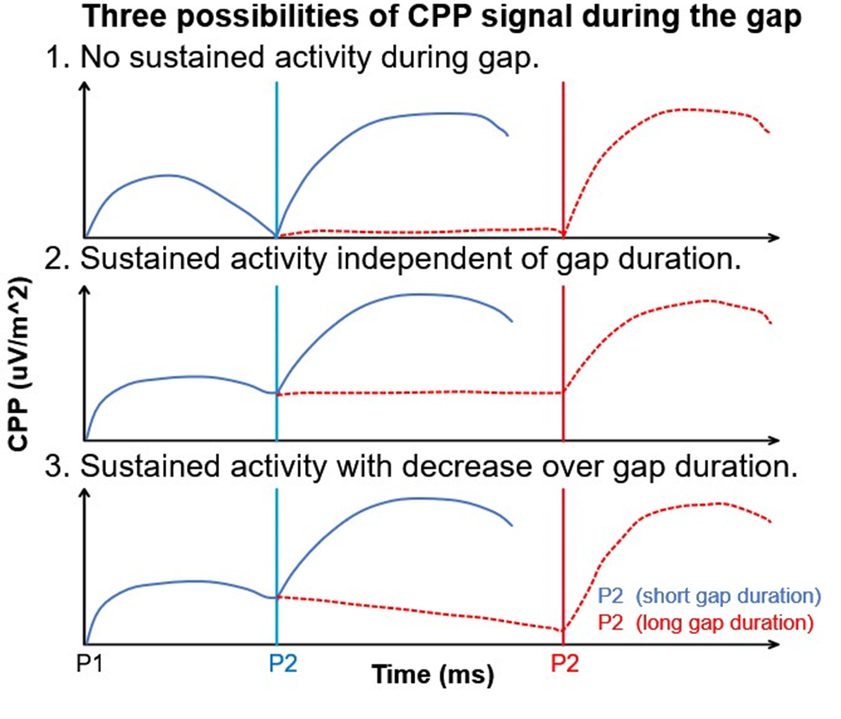
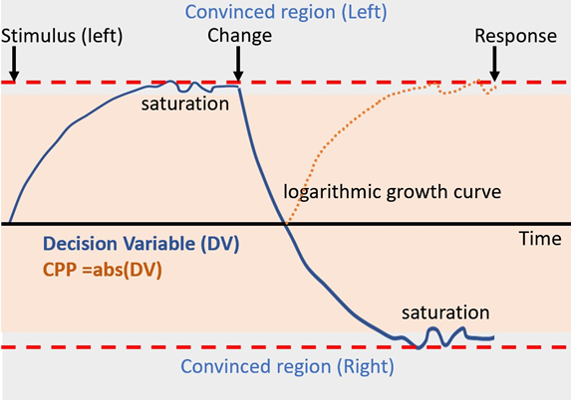
Aim of the project & Hypothesis
The goal of the experiment is to investigate what parietal signals (like the CPP or the P3) do when accumulating discrete samples of evidence separated by various gaps:
Under stable environment; 2. Under volatile environment
Fig.2 Schematic representation of three hypotheses of CPP under stable environment.
Fig.3 Schematic representation of hypothesis of Decision Variable (DV) and CPP signal under volatile environment
Notes:
The current project was designed to be divided into two phases
In the first stage, the goal of the experiment is to investigate what parietal signals (like the CPP or the P3) do when people are accumulating discrete samples of evidence separated by various gaps under a stable environment.
The second stage of the experiment is to investigate how CPP or decision variable encodes information when the information source changed unpredictably
from moment to moment (volatile environment).

Slide 7
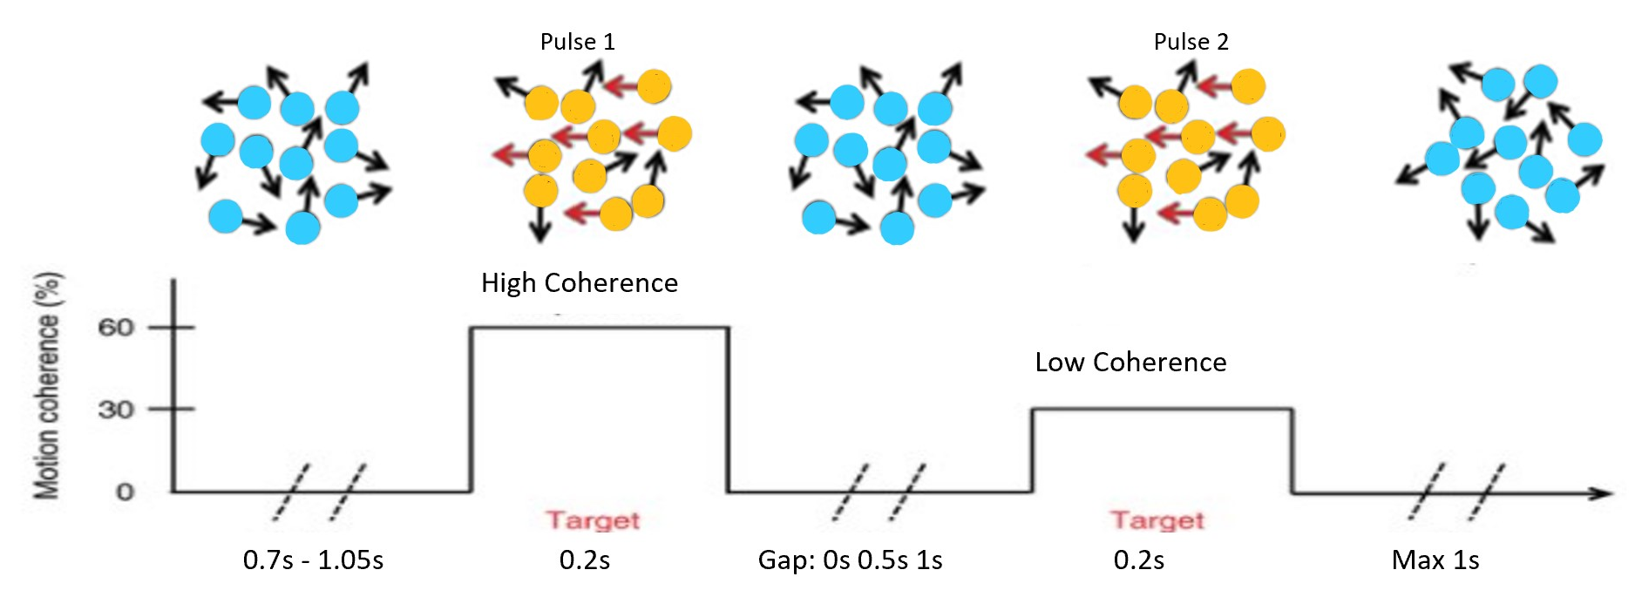
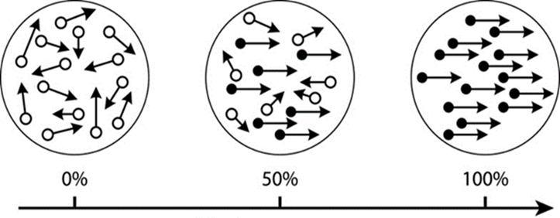
Experiment one: Stable environment
Fig.6 Sample trial for Gap analysis
Experiment variables：
1 or 2 pulse(s) trial
Gap duration in 2 pulses: 0s 0.5s 1s
Coherence of 2 pulses: low-high/ high-low
Fig.7 Example of motion coherence
Notes:
The first experiment is a random dot motion task, a cloud of dots is moving within a confined space, separated by gap, have same directions. And participants are asked to answer the direction of dots.

Slide 8
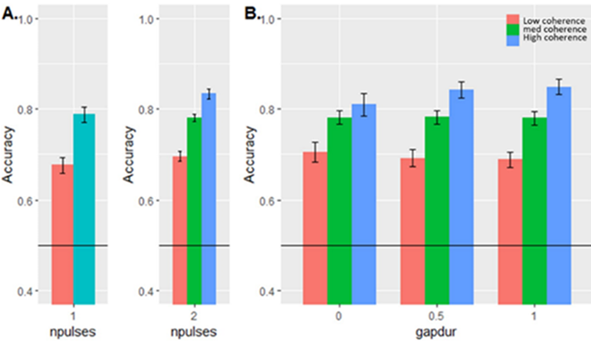
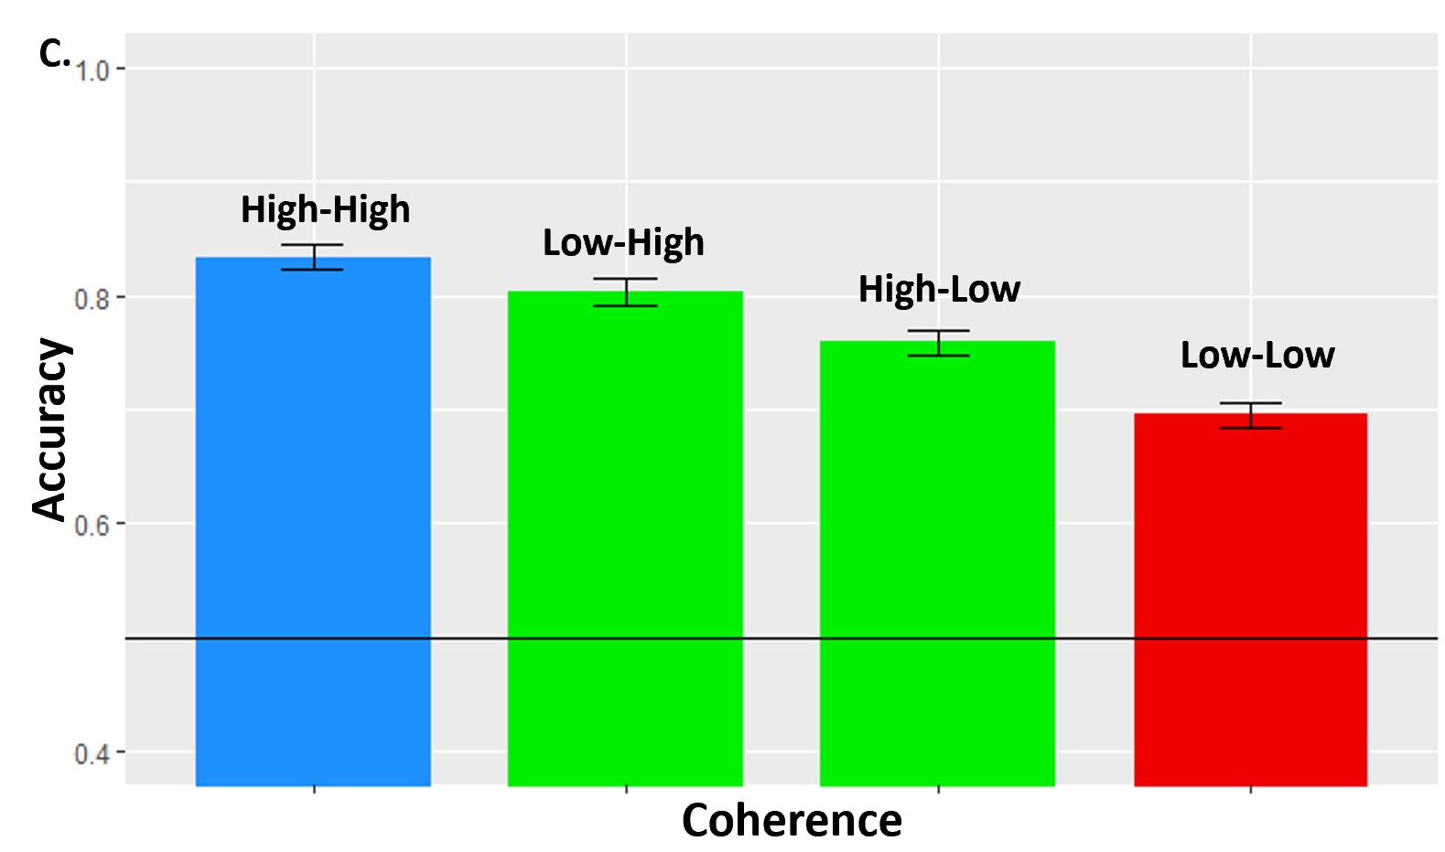
Experiment one: Statistical analysis (N=23)
Fig.8 Accuracy in single or double pulse trials with different gap duration and coherence. (A)1 pulse vs. 2 pulses; (B) 2 pulse x gap duration; (C) 2 pulse x different coherence;
2-pulses trails have higher accuracy. (A)
Accuracy doesn't decrease with the duration of the gap. (B)
The CPP falls to a greater extent after a high coherence pulse 1 (C)
Notes:
The result replicates two of the key findings of the Kiani et al. paper: figure A shows Accumulation of evidence. Figure B shows Integration process is independent with the gap. Moreover, it can be seen in figure C that when first and second pulse had different coherences, ‘Low-High’ coherence trials have a higher accuracy than ‘High-Low’ coherence trials. This means participants did slightly better when the hard pulse comes first and the easy pulse comes later, which can be explained by the fact that the first decision is usually finished before the second pulse comes

Slide 9
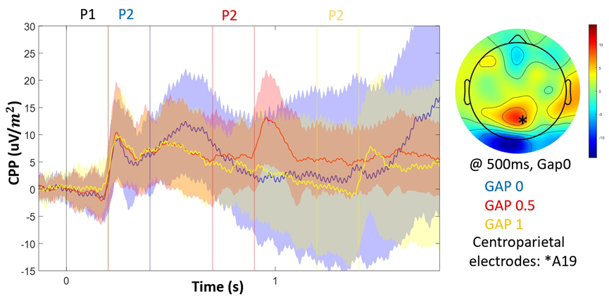
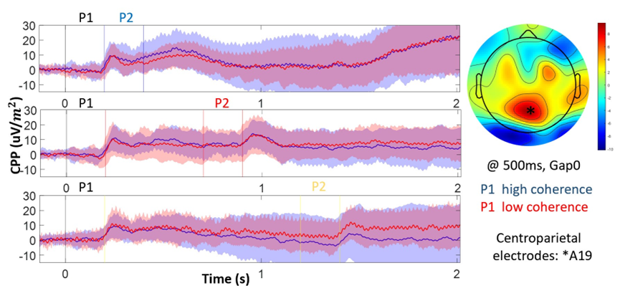
Experiment one : CPP Results
Fig.9 CPP signal sorted by gap and scalp topography at 500ms;
Fig.10 CPP signal sorted by coherence of pulse 1 and scalp topography at 500ms;
CPP signal showed a gradually increasing trend and had a high amplitude area at 500ms in the Centro-parietal area on the scalp topography. (O’Connell et al)
Hypothesis three and hypothesis one: leaky of evidence? Not correct!
CPP might reflects a decision made about each single pulse: bounded evidence accumulation decision process.
Notes:
By analysing the results from CPP results only, the dynamics of CPP seems like something in between hypothesis three and hypothesis one, which means there might
Exist some leaky of evidence.
But the CPP should be considered with the behavioural analysis together. The main idea is, if it was leaking, the behavioural performance is
expected to get worse with delay, hence hypothesis one is excluded
At the same time, the CPP signal does not show a sustained activity during the gap, hence hypothesis three is excluded
So, the remaining interpretation is that the CPP might reflects a decision made about each single pulse.
Which means participants don’t making decisions for each pulse separately, instead, they are making a bounded evidence accumulation decision on whatever information comes in. And whenever a bounded evidence accumulation is finished, they start a new one to confirm the previous one.
And figure 10 also proves that when the first pulse is easy, participants might complete their decision early, and thus be ready to fully process the
second pulse by the time it comes in.

Slide 10
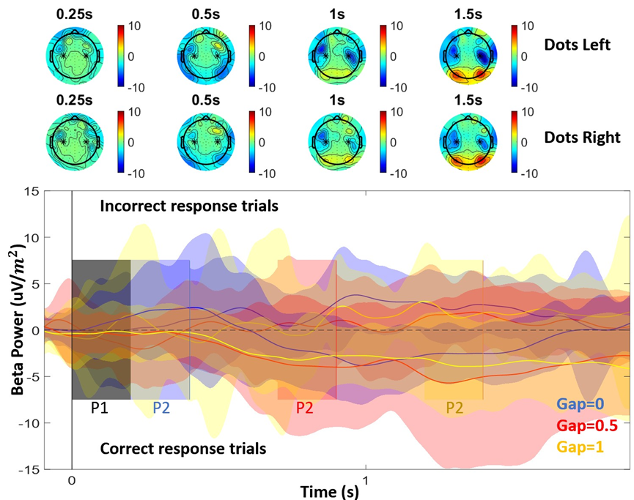
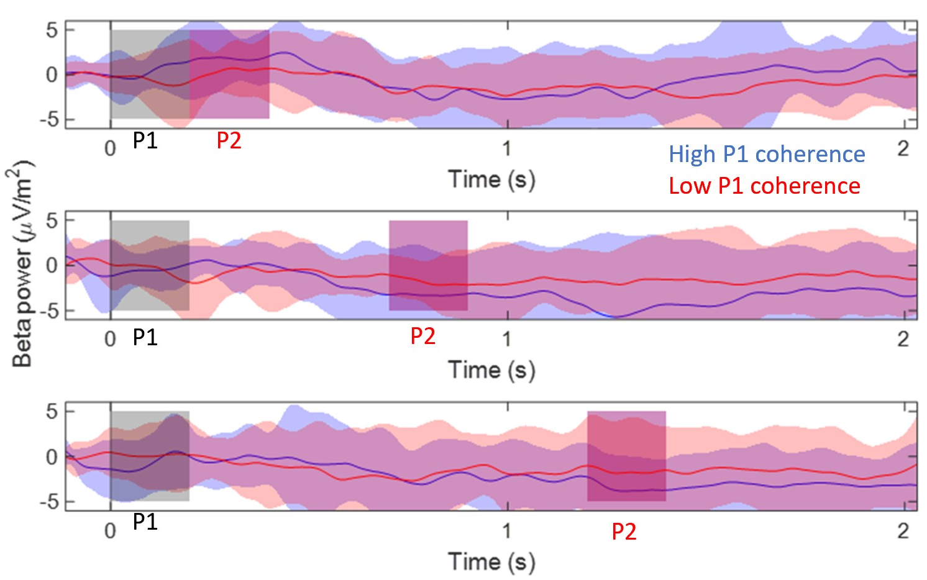
Experiment one : Beta power analysis
Fig. 11 Beta power activity sorted by gap and Chronological scalp topography.
Fig. 12 Beta power activity sorted by sorted by coherence of pulse 1
The decision is partially made in the motor areas.
Beta band activity has a close relationships with motor preparation .
For correct response trials, event-related desynchronisation (ERD) are observed after pulses.
Greater lateralisation following high-coherence P1
Notes:
Pervious studies suggests that the decision is partially made in the motor areas and beta band activity and has a close relationships with motor preparation and Desynchronizing and lateralization of Beta reflects a decision.
For correct response trials, event-related desynchronisation are observed after pulses
The scalp topography shows that when participants are holding with their right hand, the decrease in power is bigger on their left hemisphere.
it can be concluded that part of the decision is already partly made in the motor cotrex.
Figure 12 shows that higher coherence pulse 1 will induce a larger motor preparion signal
Moreover, beta band reacts almost simultaneously with the CPP, without delay it is tracing the dynamics of evidence accumulation
The decreasing of Beta power and increasing CPP means more preparation to move and more evidence towards a particular decision.

Slide 11
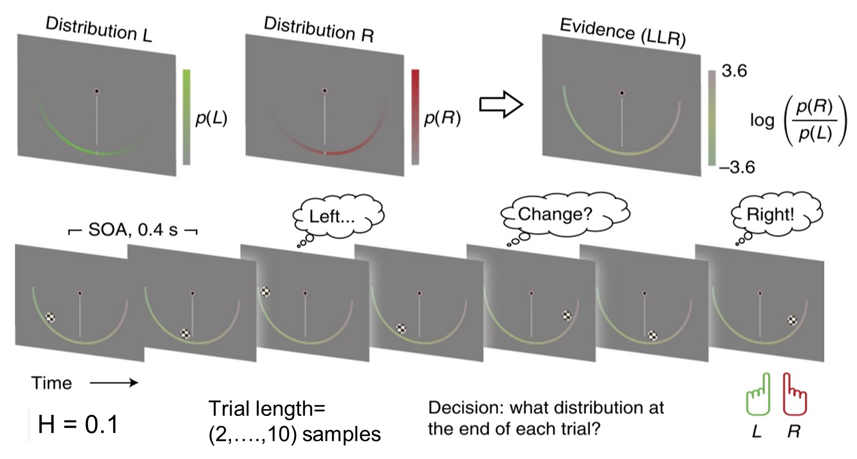
Experiment two : Volatile environment
Fig. 13 Schematic of the two-alternative perceptual choice task and Sample trail.
Experiment variables：
Hazard rate (probability of change): 0.1
Max samples per trial : 10
Notes:
The main difference of the second experiment is that the distribution of the sample dots may change from left to right, and participants should answer the distribution at the end of each trial.

Slide 12
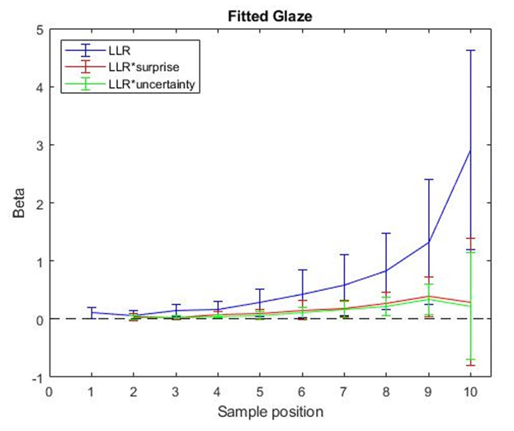
Experiment two : Regression analysis (Normative model N=12)
P(Choice) ~ LLR + LLR*Surprise + LLR*Uncertainty
‘Surprise’ : Sample suddenly becomes very informative.
‘Uncertainty’ : The weaker the belief, the greater the uncertainty.
LLR for the finial sample has a very strong impact on participants choice. (blue)
Participants are paying more attention to how surprising samples are and how convinced they are. (red and green)
Figure 14. Sample-resolved weight of evidence on choice
Notes:
We included10 including 10 samples trails only in this analysis. We used the normative model parameter fits for each participant to reconstruct the LLR values of the stimuli participants saw on each trial, and to calculate how much those influenced their choices over the course of the trial.
the regression results show that: (1) The weight of LLR increased over trial time (i.e. later samples were weighted more than earlier ones), and the finial sample have the largest impact on participants choice. (2) LLR is modulated by Surprise and Uncertainty later in the trial.

Slide 13
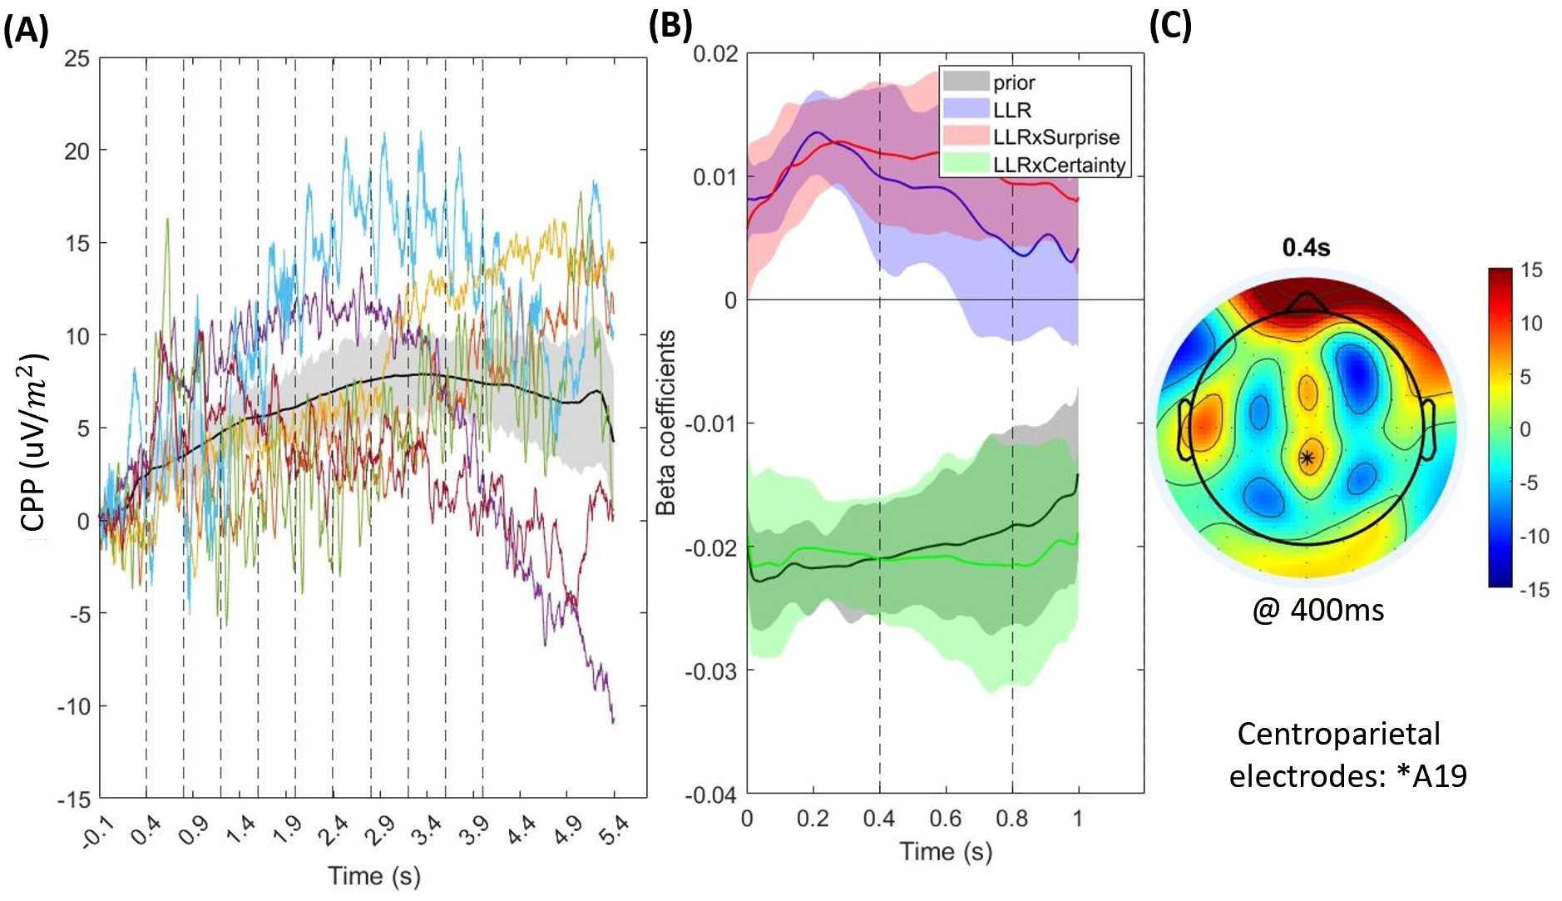
Experiment two : Regression analysis
The average CPP over time seems to build slowly across all the samples.
CPP is retaining the continuous cumulative evidence.
CPP or decision variable seems gradually flattens out in the saturated region.
Fig.15 EEG regression results. (A) CPP’s building up trend; (B) Regression results; (C) Scalp topography at 0.5s
The regression of EEG data is using the formula from Murphy’s paper:
EEG(e,t,s) = -|prior(s)| + |LLR(s+1)| + |LLR(s+1)|*surprise +|LLR(s+1)|*(-|prior(s)|)+ session covariate
Notes:
the average CPP over time seems to build slowly across all the samples. This is different from the hypothesis that CPP pop up for each sample and then fall back to zero. So, in the volatility task, it seems that the CPP is retaining the continuous cumulative evidence. In other words, the baseline is
increasing between the samples, indicating that the cumulative evidence is increasing over time. Moreover, the shape of the increasement in the figure shows that the CPP or decision variable don’t just linearly grow up, it seems gradually flattens out in the saturated region

Slide 14
Conclusions - New properties of the CPP are investigated !
CPP can serve its evidence accumulation function in different ways depending on the dynamics of evidence presentation.
The optimal strategy in stable environments is perfect (lossless) accumulation and in the volatile environment is leaky accumulation.
In experiment 1, CPP did not sustain perfectly through gaps, but instead dropped over time in a way that was consistent with two successive bounded accumulation decisions.
In experiment 2, CPP did show a gradual rise over the series of stimuli that saturated, consistent with a single, leaky accumulation process.
Notes:
To sum up, the optimal strategy for making decisions from discrete signals in a stable environment is bounded evidence accumulation. And for volatility environment the
optimal strategy is belief updating using this nonlinear function
Both of these decisionmaking scenarios involve both the motor and visual cortices, and the latter requires
more working memory.
In gaps task, it seems that participants do make two successive decisions, and it's not perfectly sepreated for pulse one and pulse two, but depends on whether the theshold boundary is reached
In exp 2, The decision variable tracks cumulative evidence gradually and will saturate at a certain level, which remains the sensitivity to the change; and CPP can visualize the absolute value of the decision variable.

Slide 15

Finally, I would like to thank my supervisors, Simon and Elisabeth from Electrical and Electronic Engineering. I feel very lucky to become their student and they brings me to the exciting world of neuroscience.
Notes:
Finally, I would like to thank my supervisors Simon, Elisabeth and Peter for their guidance and help. And thanks for listening.

Slide 16
References
[1] Murphy PR, Wilming N, Hernandez-Bocanegra DC, Prat-Ortega G, Donner TH. Adaptive circuit dynamics across human cortex during evidence accumulation in changing environments. Nature Neuroscience, 2021. 24(7):987-997. doi: 10.1038/s41593-021-00839-z.
[2] O’Connell RG, Dockree PM, Kelly SP, A supramodal accumulation-to-bound signal that determines perceptual decisions in humans. Nature Neuroscience, 2012. 15, 1729-35.
[3] S. P. Kelly and R. G. O'Connell, "Internal and external influences on the rate of sensory evidence accumulation in the human brain," Journal of Neuroscience, vol. 33, no. 50, pp. 19434-19441, 2013.
[4] S. P. Kelly and R. G. O’Connell, "The neural processes underlying perceptual decision making in humans: recent progress and future directions," Journal of Physiology-Paris, vol. 109, no. 1-3, pp. 27-37, 2015.
[5] C. A. Devine, C. Gaffney, G. M. Loughnane, S. P. Kelly, and R. G. O'Connell, "The role of premature evidence accumulation in making difficult perceptual decisions under temporal uncertainty," Elife, vol. 8, p. e48526, 2019.
[6] R. Kiani, A. K. Churchland, and M. N. Shadlen, "Integration of direction cues is invariant to the temporal gap between them," Journal of Neuroscience, vol. 33, no. 42, pp. 16483-16489, 2013

Slide 17
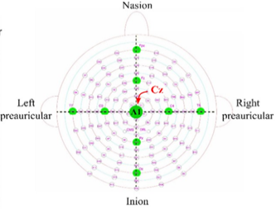
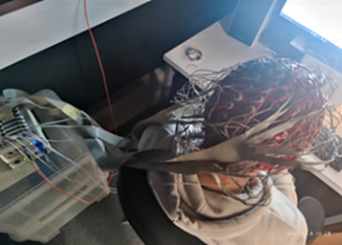
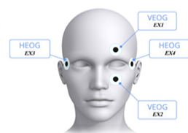
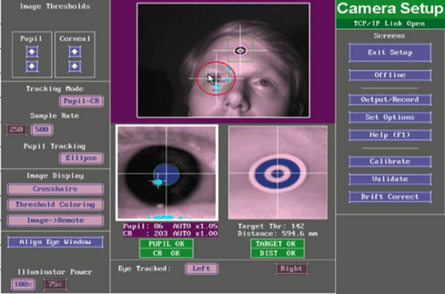
Methods : Data collection
EEG → Active Two System (Bio-semi)
Eye-tracking data → Eye-link 1000
128-channel EEG → electrical brain activity at the scalp
4 external electrodes EOG → Eye movements and blinks
4 external electrodes EMG → Hands (Thenar muscle)
Fig.4 128 EEG channels location (left); EEG cap (right)
Fig.5 External EOG channels location (left); Eye-link system interface(right)

Slide 18
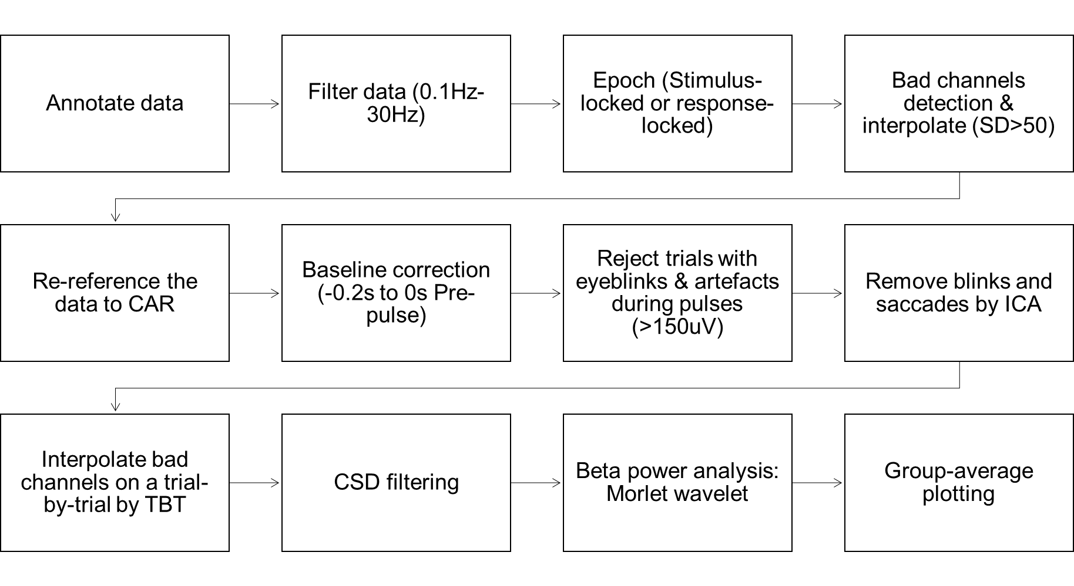
Experiment one: Data processing (ERPs)

Slide 19
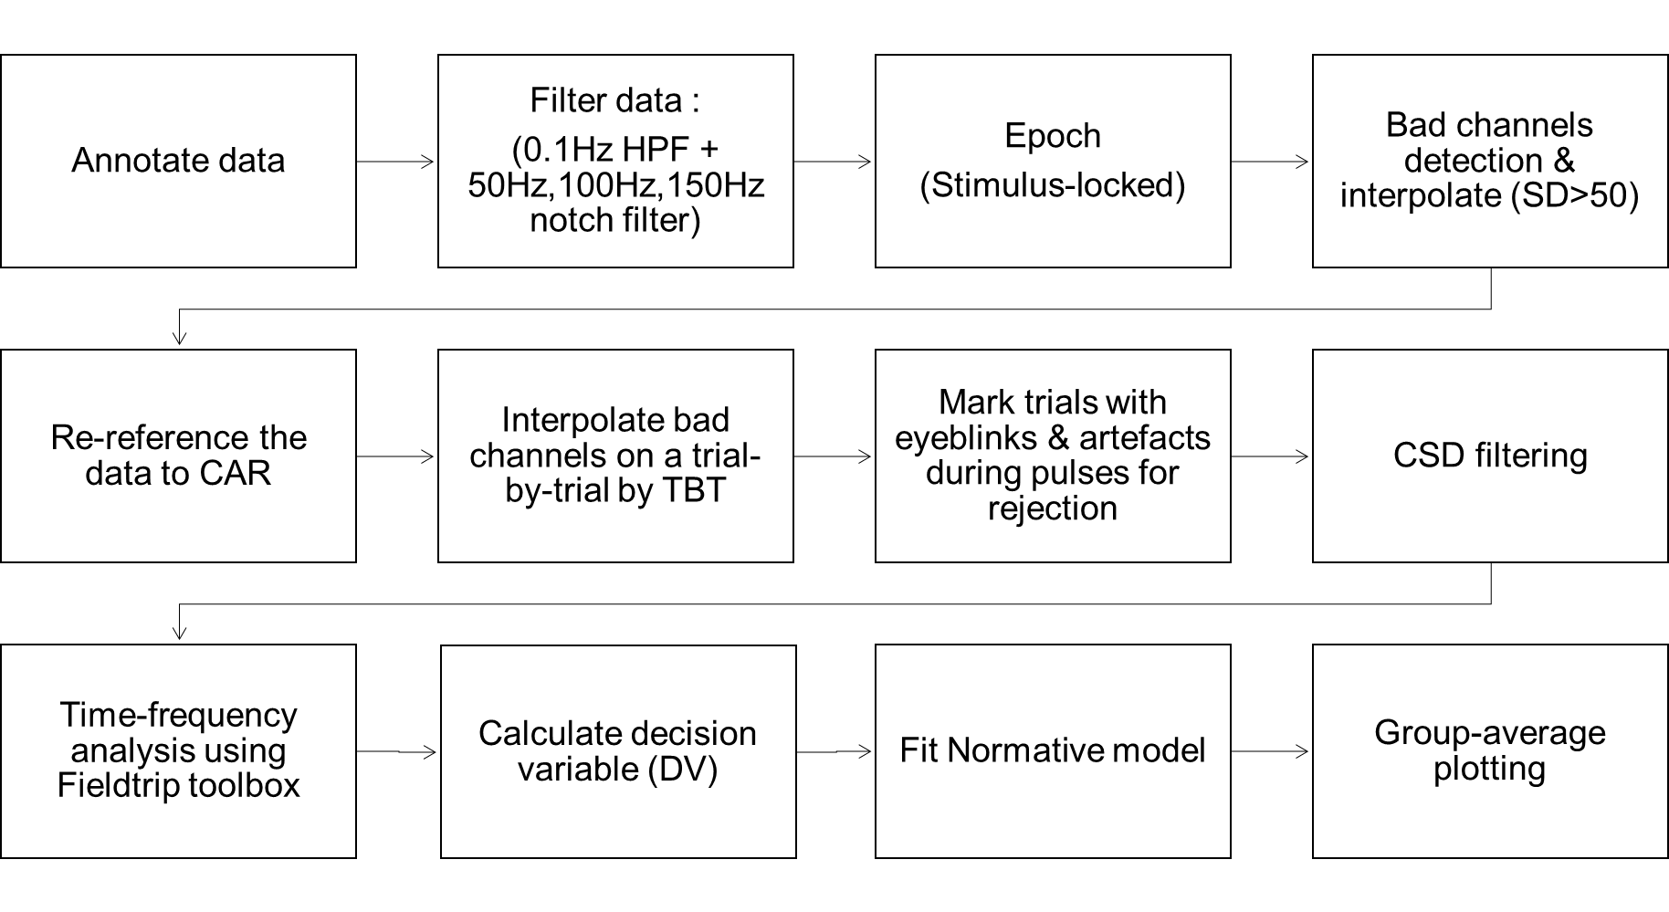
Experiment two : Data processing (ERPs)
10 samples

Slide 20
Outline of the future work
Notes:
This project critical to our understanding of the function of this signal and therefore how it might be used to assess brain function in health and disease.
This study will provide important information about the neural mechanisms of perceptual decision-making. This will not only broaden our general understanding of decision-making but also may be useful to future research to develop diagnostics and clinical tools for psychiatric and neurological disorders.

Slide 21
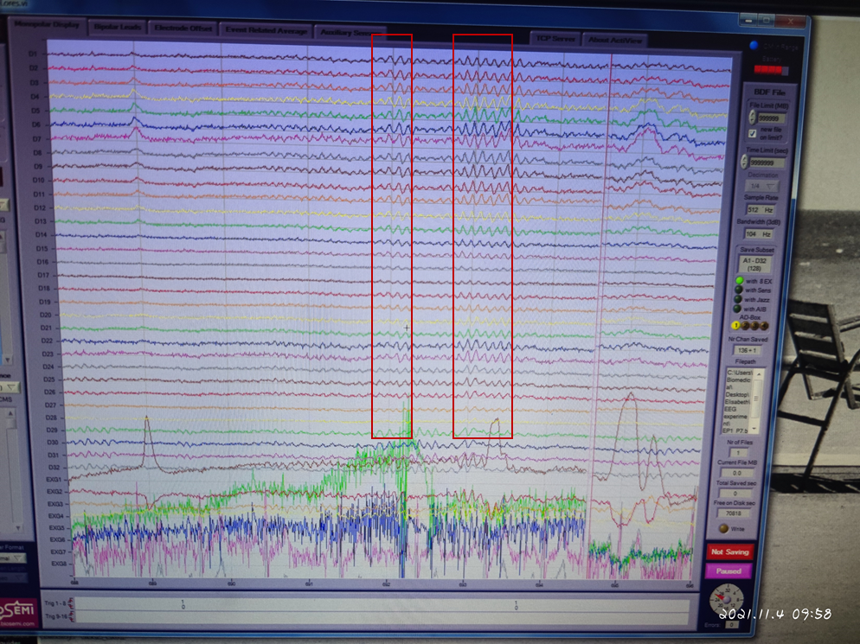
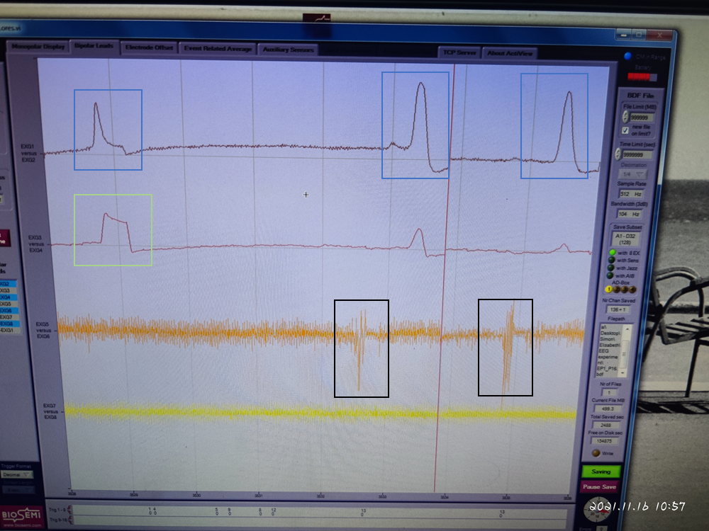
Next step: EEG data processing
Initial interpolation of bad channels
Common average re-referencing (CAR)
Filtering(0.01-30Hz)
Epoch:
Stimulus locked[-1.5 3s] to Pulse 1
Response locked [-2 1s] to action
Rejection trails with eyeblinks and eye movements
Baseline choosing [-0.2 0]
CSD transformation to baselined data
Figure.16 Example of α-wave
Figure.17 Example of EOG and EMG
Notes:
And the results is critical to our understanding of the function of this signal and therefore how it might be used to assess brain function in health and disease

Slide 22
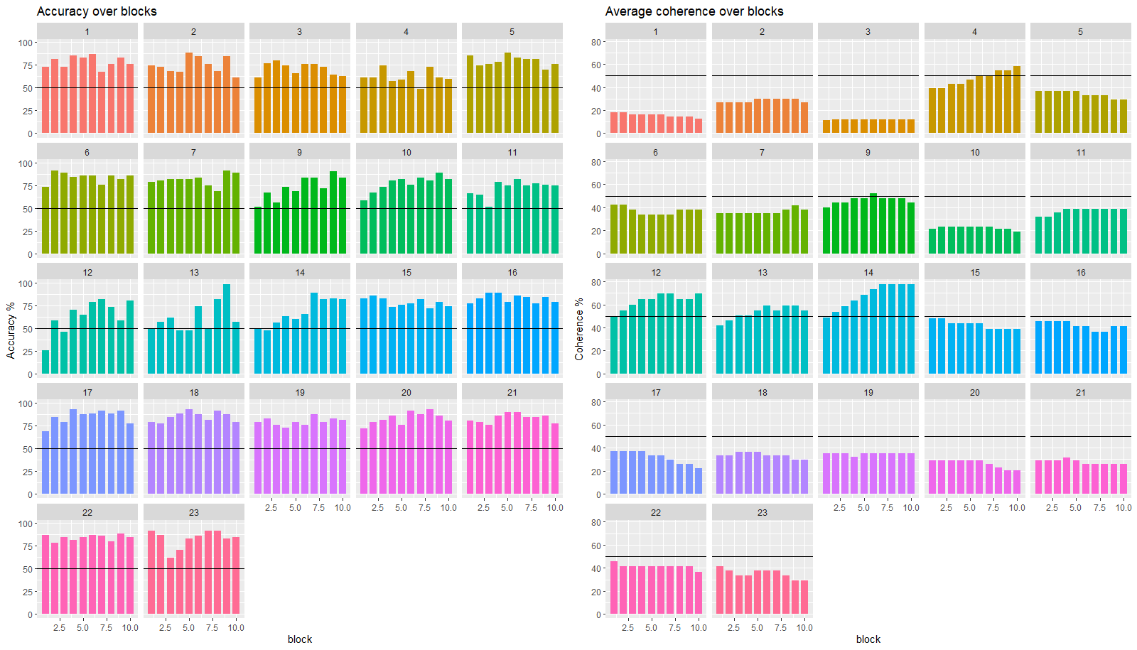
Experiment one : Behaviour data (23 participant; 1 excluded)
Figure.13 Accuracy and coherence of all 23 participants over 10 blocks
Notes:
adjustments of coherence kind of over time maintains accurate, like, maintain performance at a certain level
all participants performed above chance or like on average, that's 70% performance
people could do the task.
the horizontal line is at 50%. This would be chance, and you can see that all of the participants are above.
plots on the right, is that participants needed different amounts of evidence to perform the task well,
we adjusted difficulty for that over all participants could perform the task at a certain level and some participants needed higher coherences than others to perform the task of building wealth

Slide 23


What is Decision-making
dynamic process
begins with the accumulation of evidence
ends with the adjustment of belief
What is evidence of accumulation?
Noisy sensory information is sequentially sampled until sufficient evidence has accrued to favour one decision .
Figure.2 Schematic representation of an accumulation model[13]
Example of discrete samples of evidence:
Zoom call → unstable connection
Example of volatile environment:
Zoom call → suddenly changing from one topic to other topic
Notes:
Decision-making is a dynamic process that begins with the accumulation of evidence and ends with the adjustment of belief. Each step is itself subject to a number of dynamic processes, such as planning, information search and evaluation.
Schematic representation of an accumulation-to-bound model. The model assumes that sensory information starts to accumulate over time at a certain starting point, and with a certain accumulation rate, until a decision threshold is reached. The non-decision time is the time needed to encode sensory information and/or execution of a motor response.
Accumulation of evidence in decision making is the process by which noisy sensory information is sequentially sampled until sufficient evidence has accrued to favor one decision over another or others
improve our judgements by averaging-out the noise, and discarding past information

Slide 24
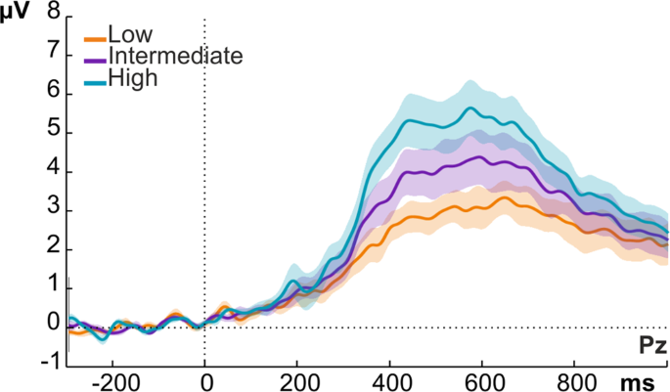
Brief overview of the background to the problem
1916
First use of accumulation model for explaining behavior
2004-2012
Accumulation and integration of evidence is involved in the decision-making process. [4-6]
2012-2019
Signal in EEG recording grows in amplitude when make a decision.[1-3]
Figure.2 Schematic representation of an accumulation model[13]
Figure.3 EEG signature of sensory evidence accumulation during decision [14]
Notes:
Evidence accumulation models (EAMs) have been the dominant models of speeded decision-making for several decades. These models propose that evidence accumulates for decision alternatives at some rate, until the evidence for one alternative reaches some threshold that triggers a decision
Fifteen years ago, Research shows evidence accumulation is involved in the decision-making process
A decade ago Human EEG studies have described a signal that reflects the gradual accumulation of evidence over time [2]

Slide 25
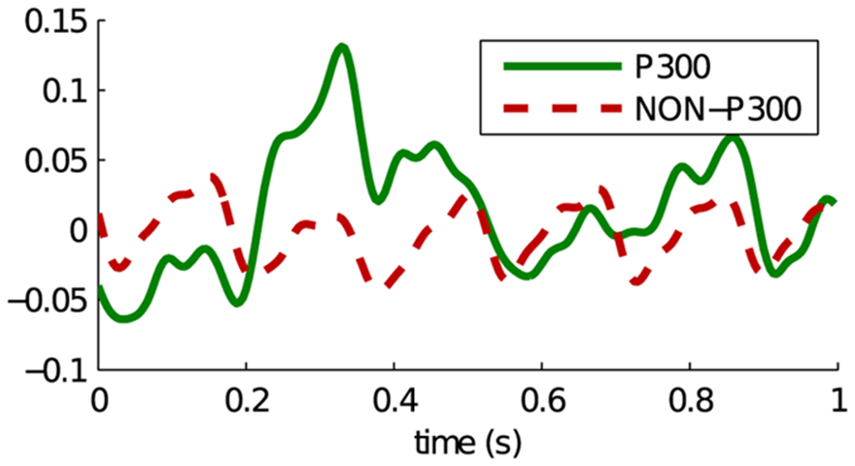
Signal linked to decision-making: P300 (P3) wave
1965, Sutton
It's been measured in a lot of clinical populations
Provides information about cognitive processes in the brain[10].
Occurs 300ms post- stimulus
Figure.4 Plot showing the average P300 response versus the average background EEG.[10]
Notes:
The P300 (P3) wave is an event-related potential (ERP) component elicited in the process of decision making. It is considered to be an endogenous potential, as its occurrence links not to the physical attributes of a stimulus, but to a person's reaction to it
It's been used for 70 years
The amplitude and latency of the P300 component provides information about cognitive processes in the brain, such as memory, attention, concentration and speed of mental processing
It's been measured in a lot of clinical populations
it hasn't been been clear how to interpret any of those differences, because the meaning of the signal itself hasn't been clear, characterizing the signal and what it does for these real life decisions, could have major implications for the use of the signal and diagnosis.

